Slide 1
DATA PIPELINE FOR BUSINESS ANALYTICS
Designing and Validating FirstBank Nigeria
Customer Segmentation Data Pipeline
BAN6800: Business Analytics Capstone | Module 3 Assignment | Nexford University
Prepared By: OFURE MARIANE IREGBEYEN
21-08-2026
GitHub: github.com/OfiIreg/FirstBank-customer-segmentation

Slide 2
The Business Analytics Use Case
Carried forward from Module 1 and Module 2, unchanged
Problem
Analytics Type
This Module's Job
FirstBank Nigeria's 42M+ retail customers receive undifferentiated marketing. Relationship managers rely on demographic proxies, not behavior.
Predictive (behavioral clustering + propensity scoring) and prescriptive (next-best-offer recommendation), as scoped in Module 1.
Build the pipeline that turns raw transaction data into the clean, validated, governed feature table the Module 4 model will train on.
Connects to the Module 2 Technical Architecture: Ingestion (AWS S3 + Glue) → Pipeline/ETL (Airflow + dbt) → Feature Store → Modeling (SageMaker). This module builds the Ingestion-through-Feature-Store portion of that diagram, in Python, against real data.
2

Slide 3
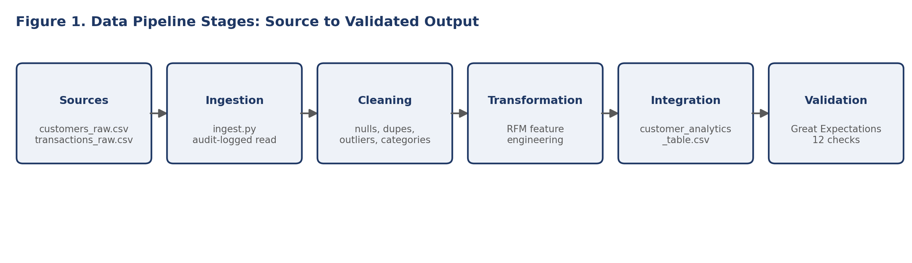
Mapping the Data Pipeline
Sources → Ingestion: raw customer and transaction extracts, standing in for FirstBank's core-banking export. Cleaning → Transformation: quality fixes, then aggregation into recency/frequency/monetary behavioral features. Integration → Validation: demographics joined with behavior into one table, then checked against 12 Great Expectations rules before handoff.
Orchestrated by Prefect DAG
Every stage privacy-audit logged
3

Slide 4
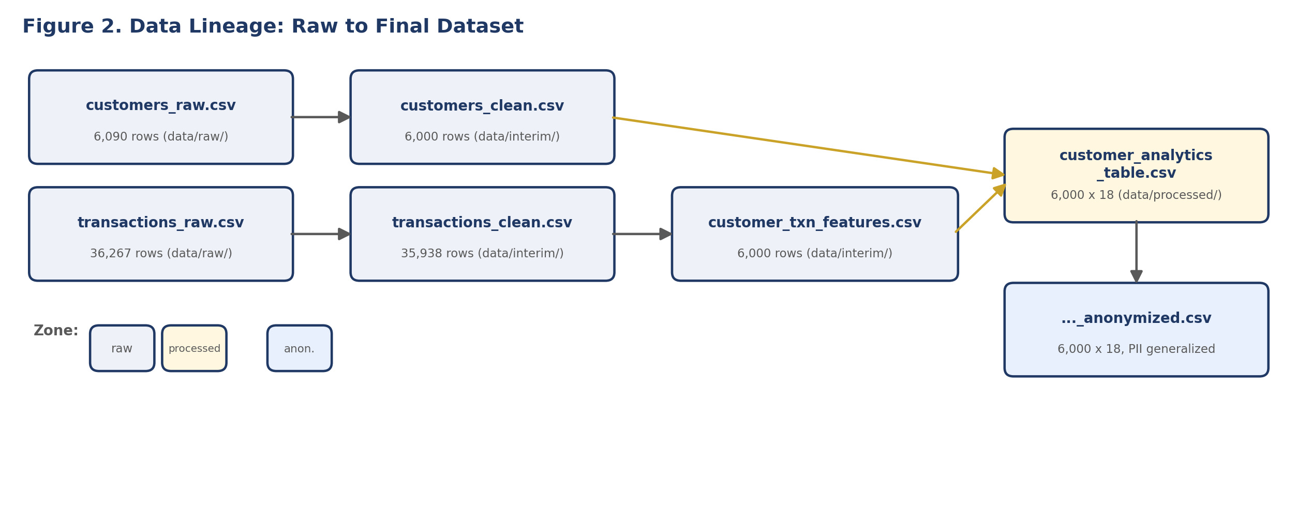
Data Inputs and Outputs
Sources, from the Module 2 Data Dictionary
Source | Type / Format | Frequency | Records
customers_raw.csv | Demographic, CSV | Monthly batch (core-banking export) | 6,090
transactions_raw.csv | Transactional, CSV | Monthly batch | 36,267
Final Output
Data Lineage
customer_analytics_table.csv 6,000 rows × 18 columns — an analysis table feeding both the Module 4 clustering model and the Module 1/2 Power BI segment dashboard.
Figure 2 (full resolution) traces every row from data/raw/ through data/interim/ to data/processed/, matching the zones defined in the Module 1 repository structure.
4

Slide 5
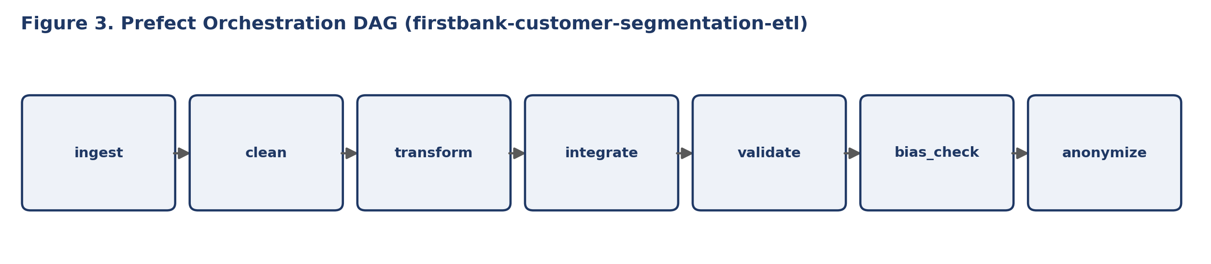
Orchestration DAG (Prefect)
@flow(name="firstbank-customer-segmentation-etl") def firstbank_etl_pipeline(): ingested = ingest_task() cleaned = clean_task(ingested) transformed = transform_task(cleaned) integrated = integrate_task(transformed) validated = validate_task(integrated) bias_checked = bias_check_task(validated) anonymized = anonymize_task(bias_checked) return anonymized
Real run, not a mockup Flow run completed successfully end to end: ✓ ingest → 6,090 + 36,267 rows ✓ clean → 6,000 + 35,938 rows ✓ transform → 6,000 feature rows ✓ integrate → 6,000 × 18 table ✓ validate → 12/12 checks passed ✓ bias_check → 2 flags raised ✓ anonymize → 6,000 × 18 output
Full log: logs/dag_run_log.txt
5

Slide 6
Key Processes: Data Preparation
Handling missing data, duplicates, and quality issues — counts are from the actual pipeline run
Issue Found | Technique | Tool | Result
90 duplicate customers | Drop exact duplicates on customer_id | pandas.drop_duplicates | 6,090 → 6,000
329 duplicate transactions | Drop exact duplicate rows | pandas.drop_duplicates | 36,267 → 35,938
Missing age/gender/location/balance | Median (numeric) / "Unspecified" (categorical) imputation | pandas | 0 nulls remain
Invalid ages (e.g., -1) | Flag out-of-range, treat as missing, impute | pandas | All ages 18–100
831 dirty category labels (e.g., "pos purchase") | Case-insensitive standardization map | pandas .str.lower() + map | 8 clean categories
180 extreme transaction outliers | Winsorize at 99.5th percentile | pandas .clip() | No value > p99.5
Free/open-source tooling throughout: pandas for cleaning, Faker for synthetic data generation — no paid licenses required.
6

Slide 7
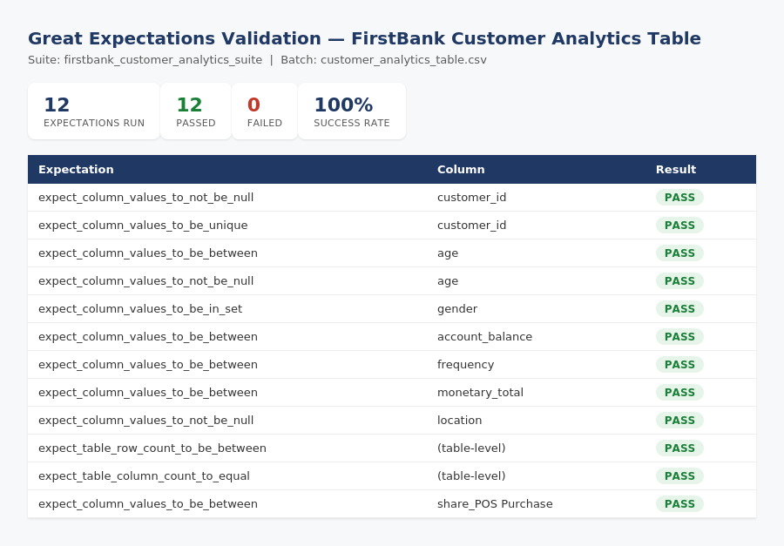
Data Validation with Great Expectations
Checks include: no nulls in customer_id/age/location, unique customer_id, plausible age and balance ranges, valid gender categories, and row/column count bounds — run against the real customer_analytics_table.csv, not a sample description.
12 expectations run 100% pass rate 0 failures
7

Slide 8
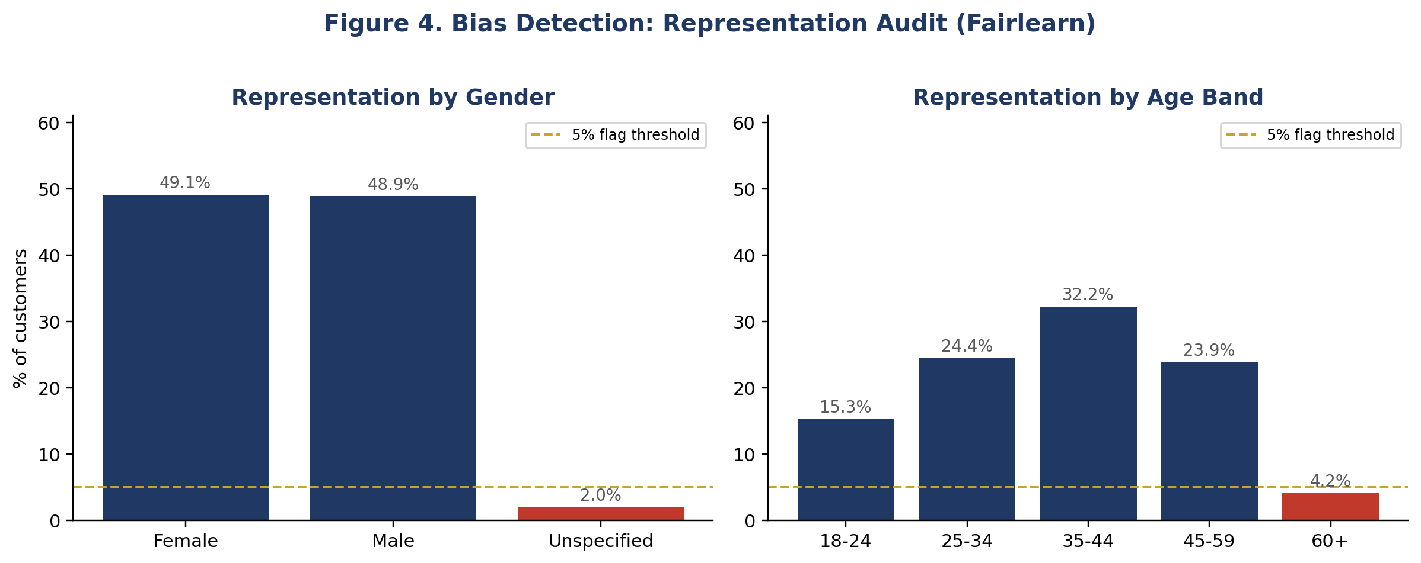
Bias Detection Suite (Fairlearn)
Representation flags ⚠ "Unspecified" gender: 2.0% of customers (below 5% threshold) ⚠ "60+" age band: 4.2% of customers (below 5% threshold) Both are routed to the Data Protection Officer for review before the segment model is trained on this population, per the Module 1 Ethical AI Charter.
This is a data-representation audit (pre-model). The Demographic Parity and Equalized Odds metrics from the Module 2 report apply once the Module 4 model produces predictions to audit.
8

Slide 9
Anonymization and Privacy Audit Logging
Data Anonymization Plan
Privacy Audit Log (sample entries)
Field | Treatment
customer_id | Salted SHA-256 hash → ANON_xxxxxxxxxxxxxxxx
age | Generalized to age_band (e.g., 35–44)
account_balance | Generalized to balance_band (e.g., 50K–500K)
location | Generalized to geo_zone (e.g., South West)
{"stage": "clean", "dataset": "customers", "rows_affected": 6000, "note": "dropped 90 duplicate customer records..."} {"stage": "clean", "dataset": "transactions", "rows_affected": 35938, "note": "standardized 831 dirty category labels..."} {"stage": "anonymize", "dataset": "customer_analytics_table _anonymized", "rows_affected": 6000, "note": "irreversibly hashed customer_id..."}
No names, phone numbers, or account numbers exist in this schema; the realistic risk is quasi-identifiers, addressed above. Small-cell disclosure risk (e.g., a customer in a rare age/balance/zone combination) is cross-checked against the Bias Detection Suite's representation flags before any anonymized export leaves the pipeline boundary. Full plan: docs/data_anonymization_plan.md
Every read, write, and transformation across all 7 pipeline stages is logged to logs/privacy_audit_log.jsonl via Python's logging module — satisfying the Module 3 audit logging requirement in full.
9

Slide 10
Governance, Reproducibility, and Containerization
Data Governance Framework
Dockerfile
• Access: raw zone — Data Engineer only; anonymized table — open to analysts • Retention: raw data 90 days; audit log kept ≥ 1 year • Usage: new use cases require AI & Data Ethics Committee sign-off (Module 1) • Traceability: every number traces to a logged transformation
FROM python:3.11-slim WORKDIR /app COPY requirements.txt . RUN pip install --no-cache-dir \ -r requirements.txt COPY src/ ./src/ COPY tests/ ./tests/ RUN useradd --create-home appuser USER appuser HEALTHCHECK CMD python -c \ "import pandas, great_expectations" CMD ["python", \
"src/pipeline/pipeline_dag.py"]
Full framework: docs/data_governance_framework.md
Reproducibility and Collaboration
• requirements.txt pins every dependency version • pytest suite (11 tests, all passing) guards the cleaning/transform logic • GitHub Actions CI runs tests + full DAG on every push • Dockerfile packages the whole pipeline for any teammate's machine
10

Slide 11
GitHub Repository
github.com/OfiIreg/FirstBank-customer-segmentation
Repository now includes (updated this module):
src/pipeline/ ingest, clean, transform, integrate, validate, bias_detection, anonymize, pipeline_dag tests/ test_pipeline.py (11 unit tests, all passing) great_expectations/ validation_result.json, validation_report.html docs/ governance framework, anonymization plan, Module 1 & 2 reports logs/ privacy_audit_log.jsonl, dag_run_log.txt Dockerfile, requirements.txt, .github/workflows/pipeline-ci.yml
Clone and run:
pip install -r requirements.txt --break-system-packages python src/pipeline/generate_raw_data.py && python src/pipeline/pipeline_dag.py
11

Slide 12
References
1. Bansal, S. (2021). Bank customer segmentation (1M+ transactions) [Data set]. Kaggle.
2. Fairlearn. (2024). Fairlearn: A Python package to assess and improve fairness of machine learning models. https://fairlearn.org
3. Great Expectations. (2024). Great Expectations documentation. https://docs.greatexpectations.io
4. National Information Technology Development Agency. (2023). Nigeria Data Protection Act, 2023. Federal Republic of Nigeria.
5. Prefect Technologies. (2024). Prefect documentation. https://docs.prefect.io
6. Python Software Foundation. (2024). logging — Logging facility for Python. Python 3 documentation.
12

